Slide 1
Map Routing Project
Brief Description

Slide 2
Agenda
Problem Definition
Input
Output
Example
Test Cases

Slide 3
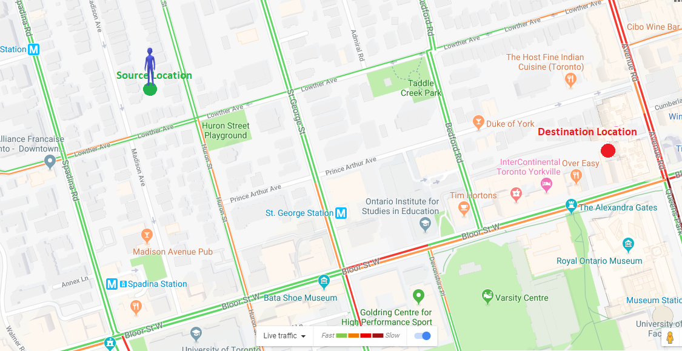
Problem Definition
The goal of the project is to find the path to go from source to destination with the least time.

Slide 4
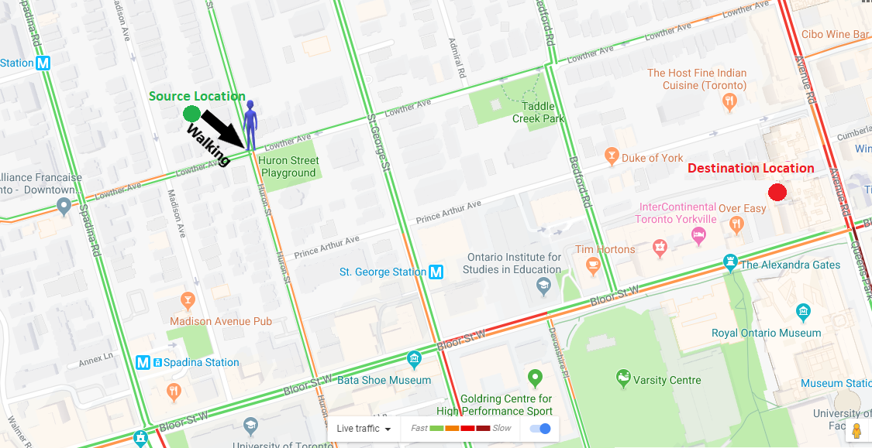
Problem Definition
The goal of the project is to find the path to go from source to destination with the least time.

Slide 5
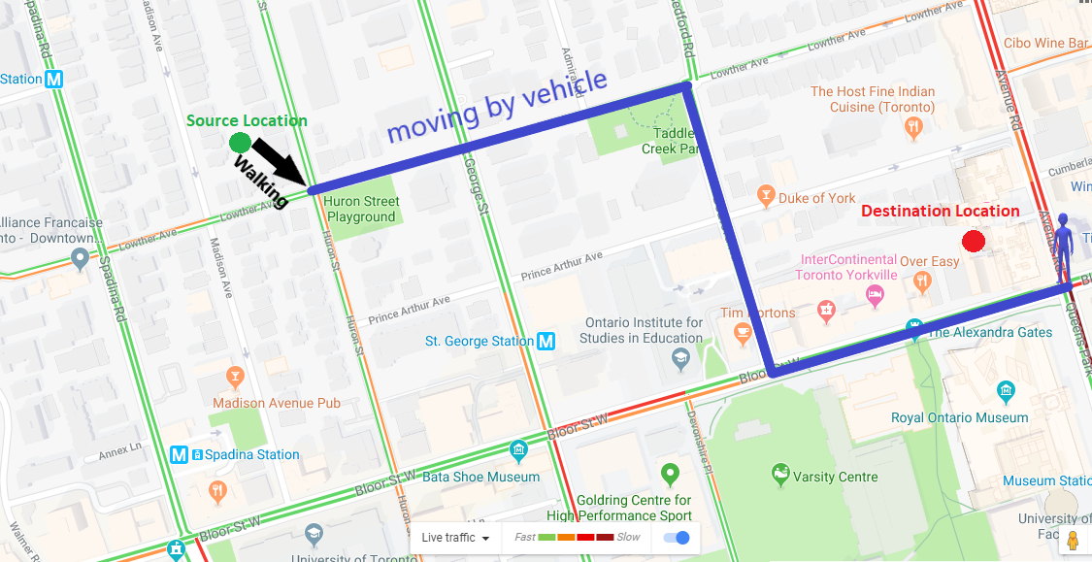
Problem Definition
The goal of the project is to find the path to go from source to destination with the least time.

Slide 6
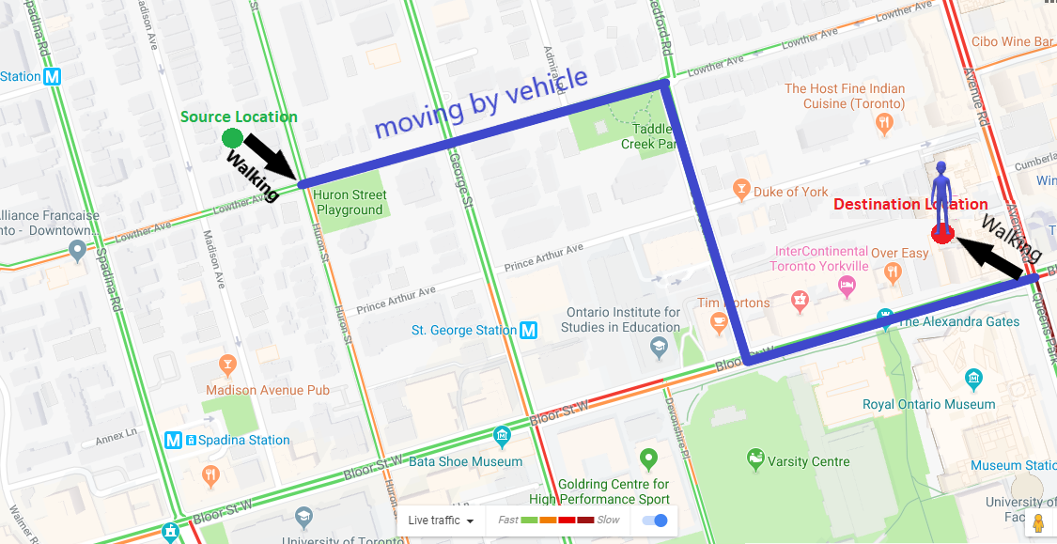
Problem Definition
The goal of the project is to find the path to go from source to destination with the least time.

Slide 7
Problem Definition
Maps: graphs whose
vertices are points in the plane and are connected by edges. Think of the vertices as intersections and the edges as roads that connect intersections.
Each road has length and speed. Vehicles on the road can not exceed its speed.

Slide 8
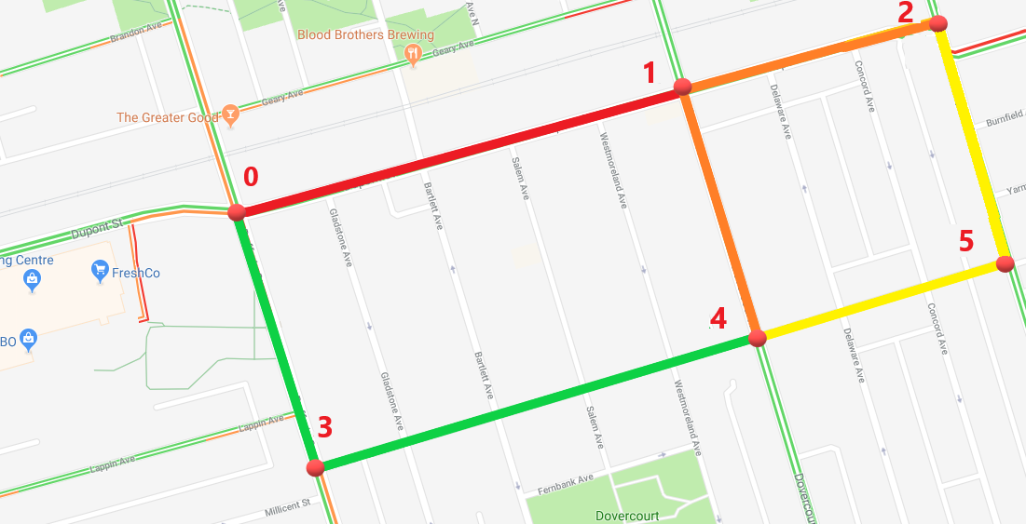
Problem Definition
In this example:
Intersection 0 is connected to intersection 3 (with road length = 0.28 km and speed = 80 km/h)
intersection 0 is connected to intersection 1 (with road length = 0.5 km and speed = 20 km/h)

Slide 9

Problem Definition
The source location is not necessarily on an intersection. The person in source can walk to any nearby intersection with speed (5 km/h).
The destination location is not necessarily on an intersection. The person can walk from any node to the destination with speed (5 km/h).

Slide 10
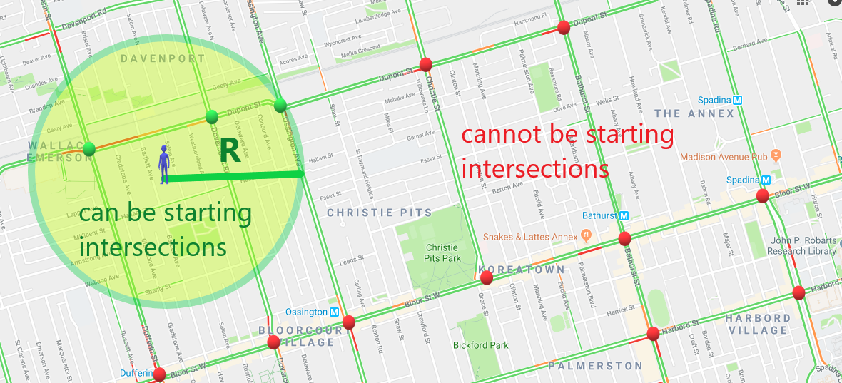
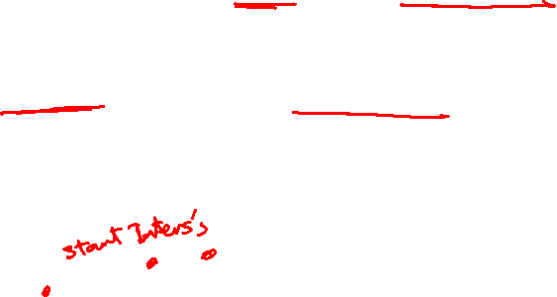
Problem Definition
The person can walk for maximum R meters to get to a starting intersection. They can also walk for maximum R meters to get from an intersection to the destination.

Slide 11
Input
Map file containing
the number of intersections and roads
list of intersections (index followed by its x and y coordinates),
list of edges (pairs of intersections, length, speed).
Queries File contains
# required queries.
x and y coordinates of Source & destination for each queries, and the maximum walking distance R.

Slide 12

Output
Program print (in a file)
The nodes of the path that has the shortest time.
Shortest time to get from source to destination.
The total length of the found path (vehicle moved distance + walked distance).
The total moving distance.
The total vehicle distance.
Total execution time of routing requests.

Slide 13
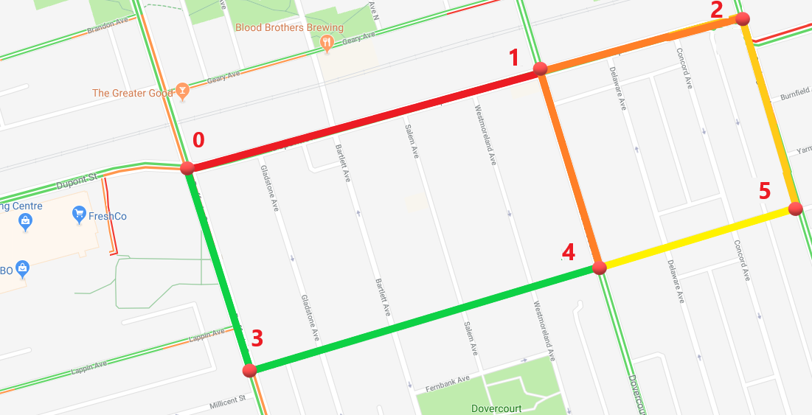
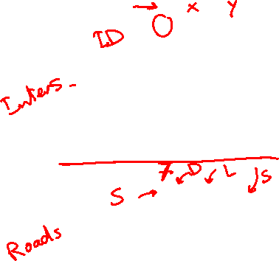
Example
Map File containing 6 vertices and 7 edges…
6
0 0.25 0.33
1 0.73 0.47
2 1.00 0.54
3 0.34 0.60
4 0.81 0.20
5 1.07 0.28
7
0 1 0.50 20
0 3 0.28 80
3 4 0.62 80
1 4 0.28 40
1 2 0.28 40
4 5 0.27 60
2 5 0.27 60

Slide 14
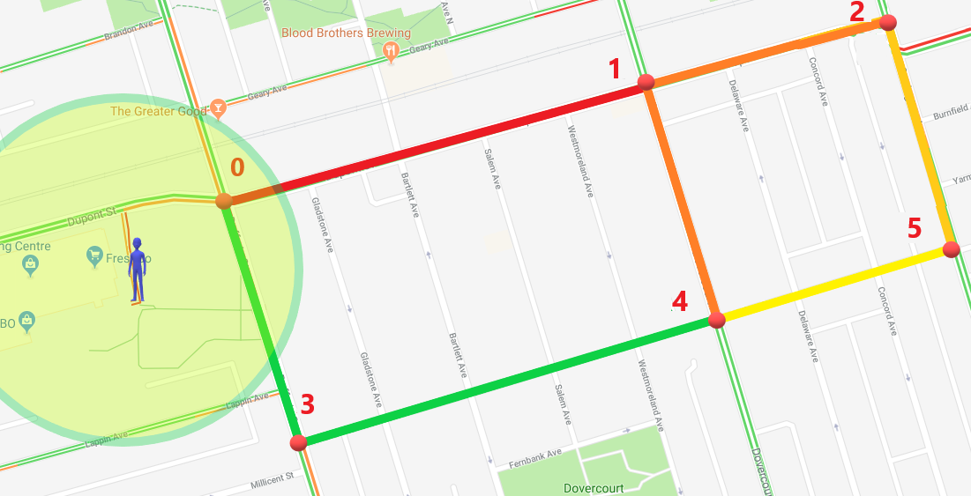

Example
Queries file containing 1 query
1
0.16 0.21 1.09 0.44 300

Slide 15
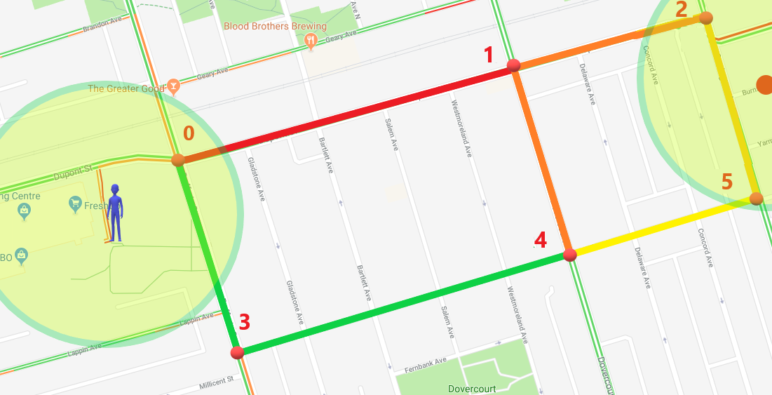
Example
Intersection 0 is the only possible starting intersection. Intersections 2 and 5 can be finishing intersections

Slide 16
Example

Slide 17
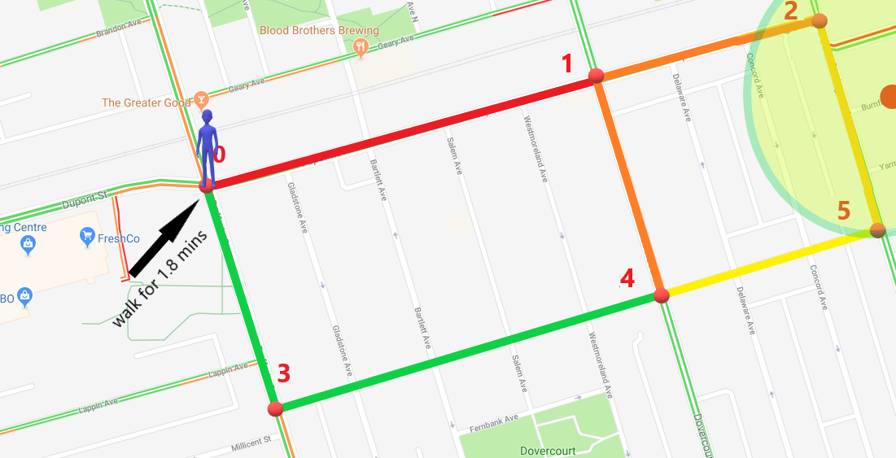

Example

Slide 18
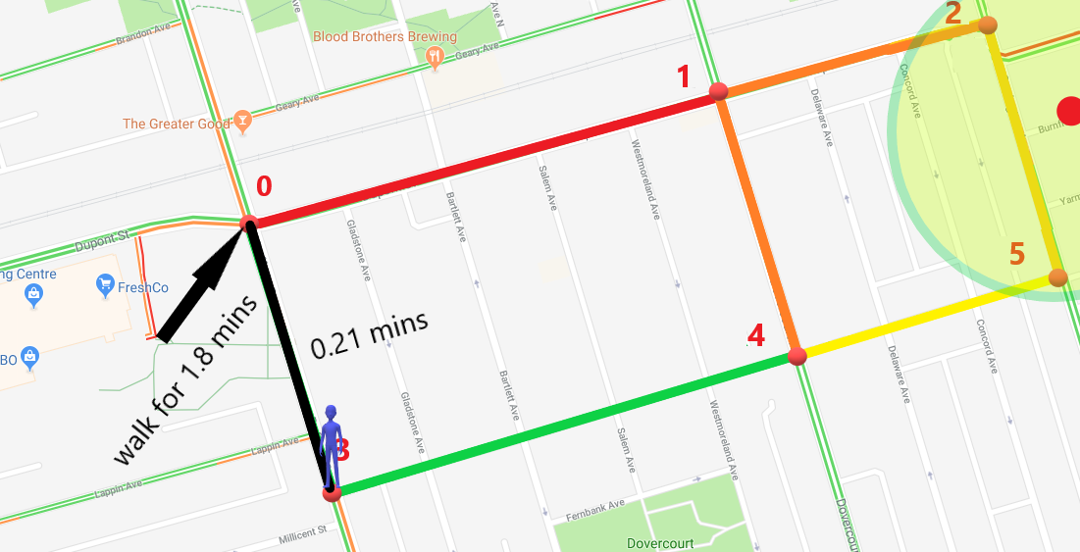
Example

Slide 19
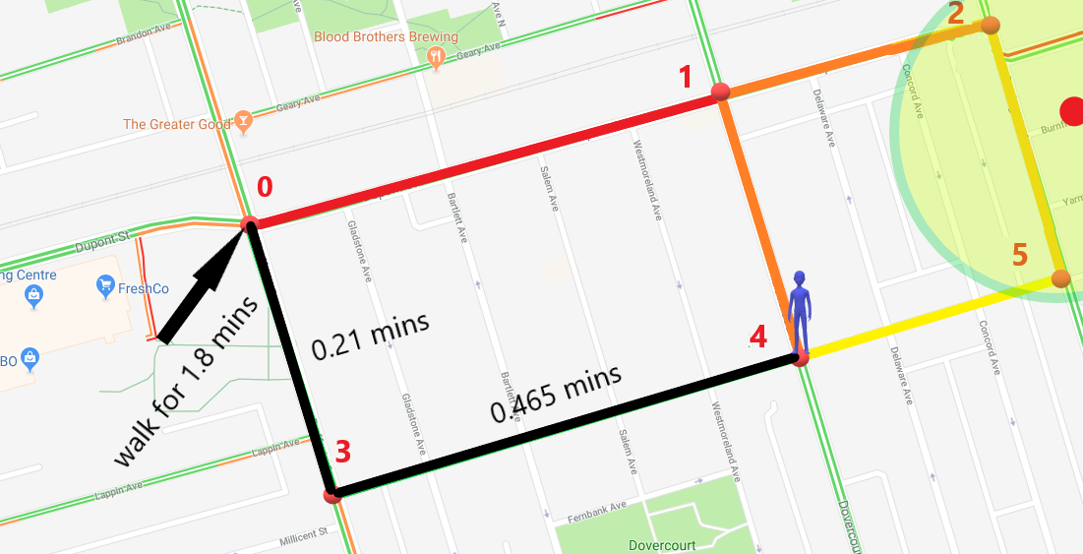
Example

Slide 20
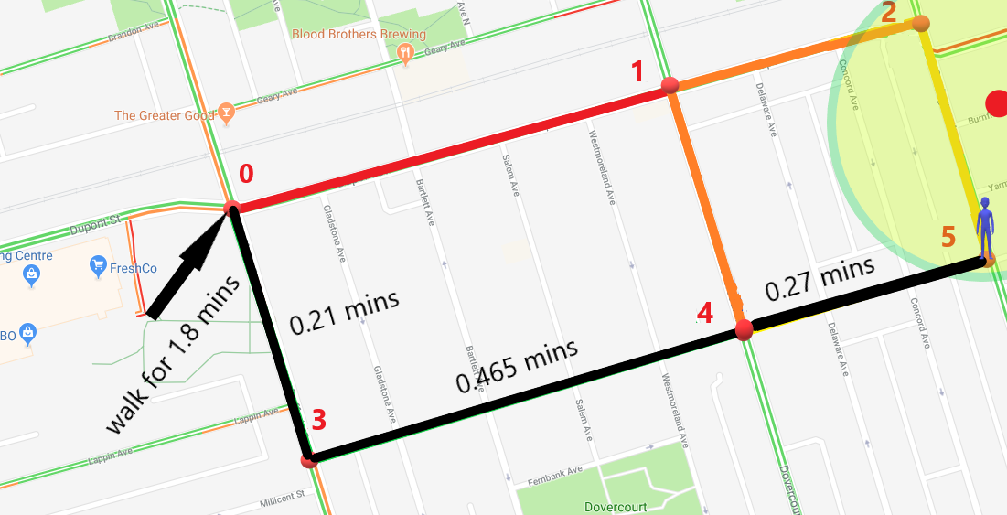
Example

Slide 21
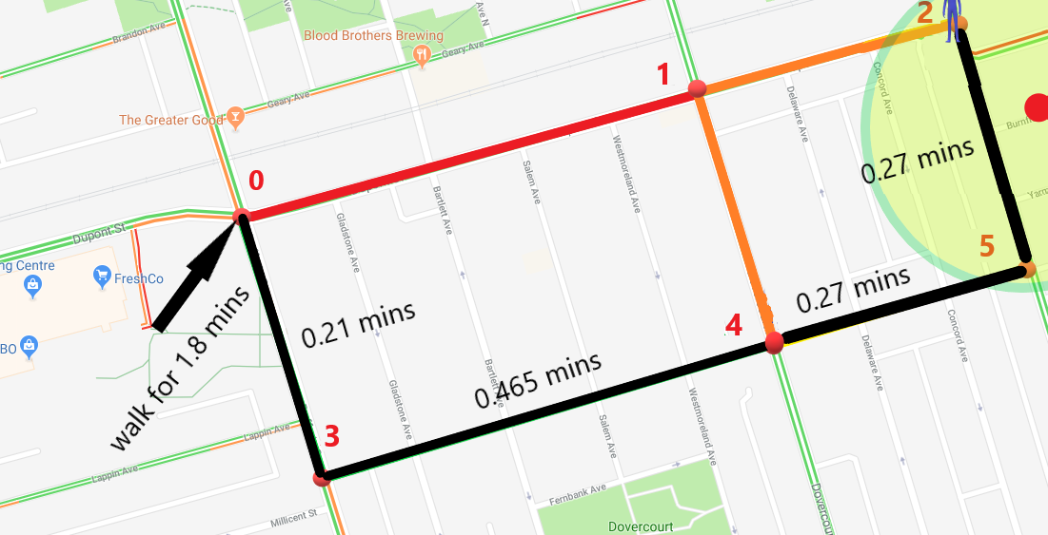
Example

Slide 22
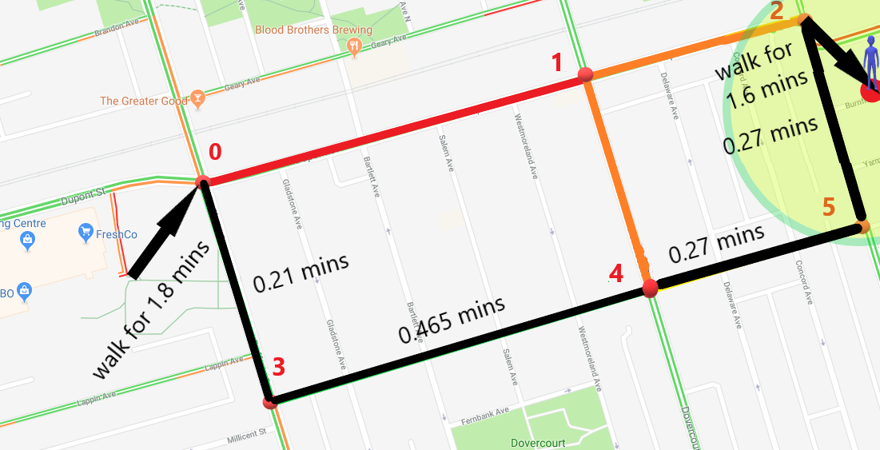
Example

Slide 23
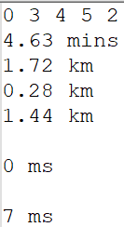
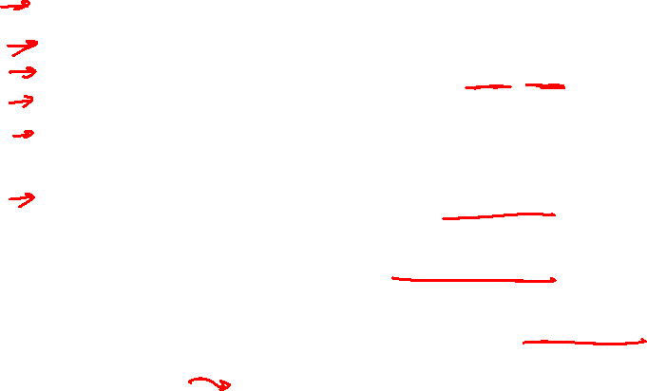
Example
OUTPUT file containing
The path nodes : 0, 3, 4, 5, 2.
Shortest time = 4.63 mins
Path length = 1.72 km
Total walking distance = 0.28 km
Total roads length = 1.44 km
Total execution time without I/O = … ms
Total execution time with I/O = … ms

Slide 24
Test Cases
1. Sample Cases
The number of intersections does not exceed 20 intersections.
The number of roads does not exceed 50 roads.
The number of queries does not exceed 10 queries.
2. Medium Cases
The number of intersections does not exceed 20000 intersections.
The number of roads does not exceed 25000 roads.
The number of queries does not exceed 1000 queries.
3. Large Cases
The number of intersections does not exceed 200000 intersections.
The number of roads does not exceed 250000 roads.
The number of queries does not exceed 1000 queries.

